Slide 1
Semi-Supervised Learning
Neerja Doshi, Prince Grover, Kishan Panchal

Slide 2
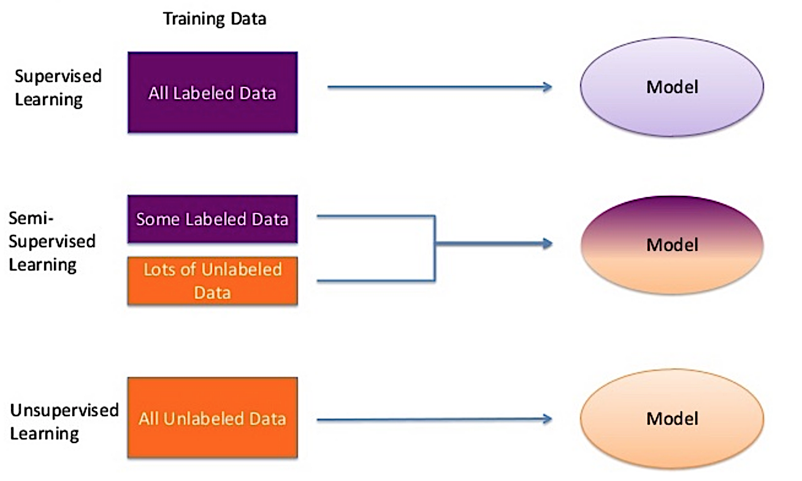
Overview

Slide 3
Pseudo-Labeling
Use both labeled and unlabeled data to build better learners than using only one of these types of data
You would use this when the size of the unlabeled data is much larger than the size of labeled data because you could just use supervised learning otherwise
Use the same model that you created with your labeled data to predict labels for your unlabeled data
Re-train your model using the originally labeled data and your pseudo-labeled data

Slide 4
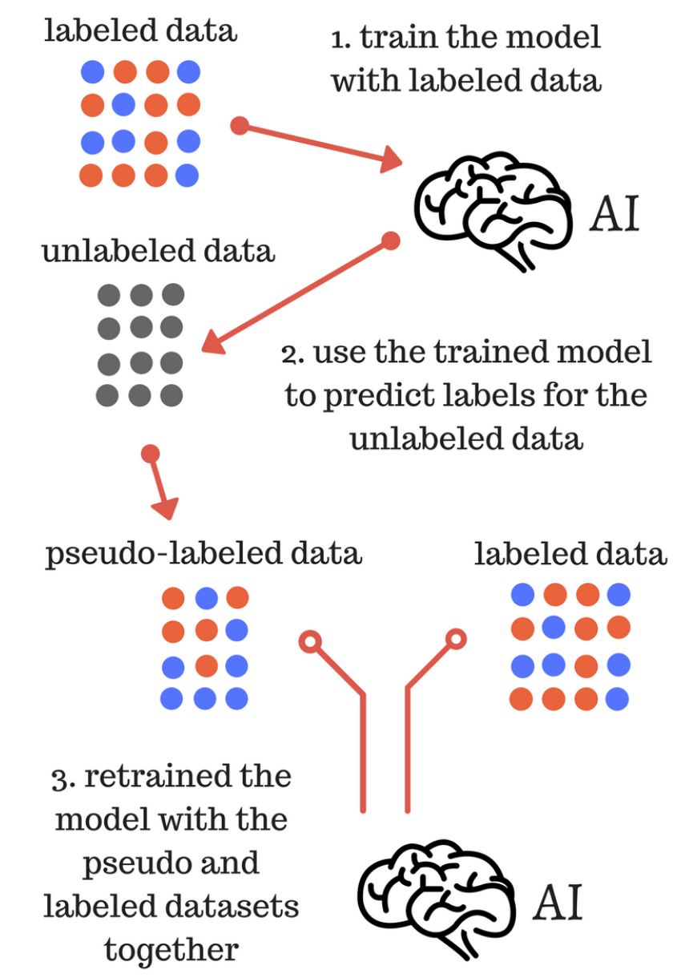
Visually

Slide 5

Type 1 - Self Training
1
0
?
?
?
?
0
1
Fit on known labels and predict on unknowns
1
0
1
0
?
?
0
1
Limited success in sentiment analysis
Bad when model predicts wrong with high confidence
if:
{prediction > threshold}
then:
{Update ?}

Slide 6
Type 2 - Multi-View Training
F(i): Feature set
F1 F2 F3 F4 F5 F6
Model 1
Model 2
Classify web-pages with text on the page as one view and
Text in hyperlinks on other pages as 2nd view
Strong assumption that features can be broken and each subset is sufficient
if:
{model-1 prediction > threshold &
model 2 prediction < threshold}
then: {prediction from model-1 in feature for model-2}

Slide 7


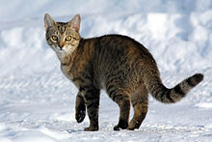


Type 3 - Self Ensembling
Training 1
Prediction (Cat)
Training 2
CAT
CAT
Good for computer vision
Models robust to noise
CAT
CAT
CAT
CAT
Test 1
?
CAT
0.8
Test 2
?
0.5
?

Slide 8
Demo
https://github.com/neerjad/SSL/blob/master/ssl.ipynb
Steps:
Fit multiple models and find the best one
Use this model to predict labels for unlabeled data
Combine the train data and the unlabeled data whose predicted probabilities satisfy the threshold values
Compute CV score to test for improvement

Slide 9
Industry Use Cases
Computer Vision Tasks
Use of hashtags as additional meta-data to assign labels for unlabeled data
Web Page Categorization
There are millions of web pages to classify
Amazon
Alexa showed a 25% increase in accuracy for spoken language understanding

Slide 10
Drawbacks
It can be difficult to tune and make work properly
May not always give a high performance boost by itself
It introduces additional complexity in exchange for a slight improvement in performance

Slide 11
References
https://datawhatnow.com/pseudo-labeling-semi-supervised-learning/
http://pages.cs.wisc.edu/~jerryzhu/pub/sslicml07.pdf
http://ruder.io/semi-supervised/

